Slide 1
Frito Lay / DDSAnalytics Research
DDSAnalytics chief data scientist - Jeff Reed
https://www.youtube.com/watch?v=Y3VLaIGCA50
https://github.com/jeffnreed/DDS_Project2

Slide 2
Analysis Discussion Overview
EXPLORATORY DATA ANALYSIS
Visualization
Statistics
PREDICTIVE MODELS
Techniques
Outcomes
SUMMARY CONCLUSION
Key insights
Recommendations

Slide 3
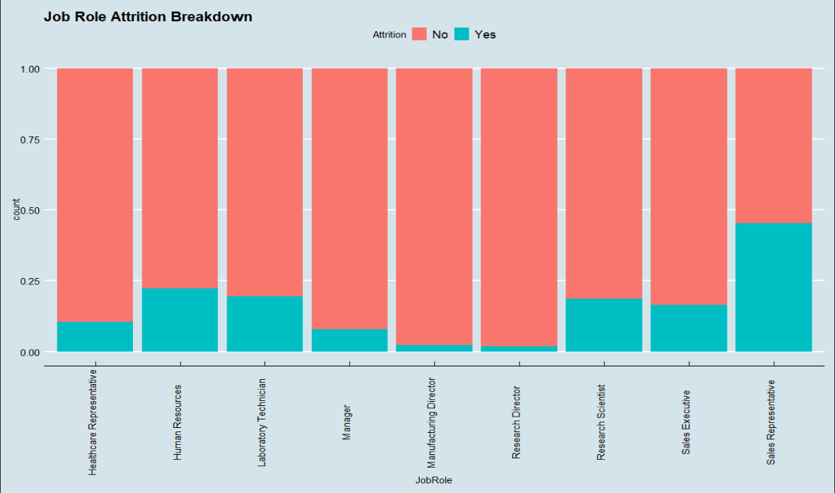
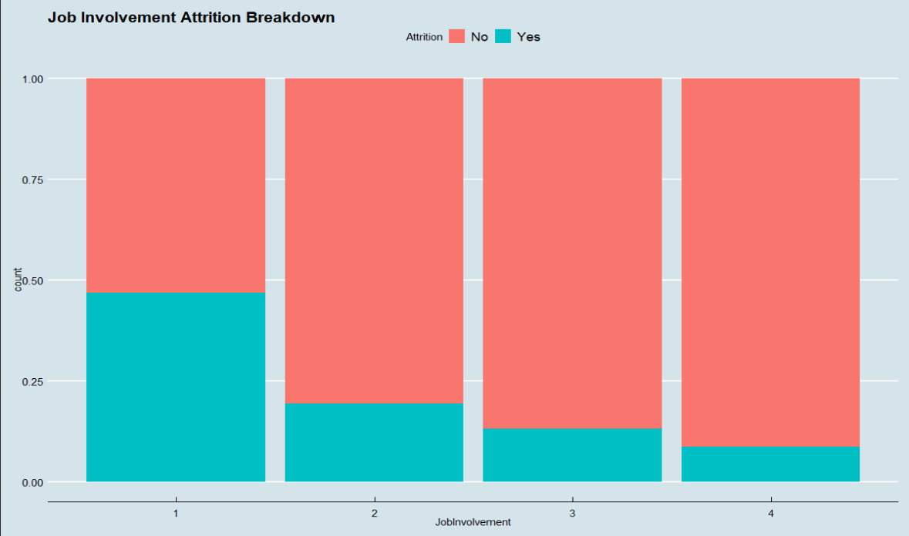
EXPLORATORY DATA ANALYSIS
Bar chart analysis breakdown of attrition (categorical variables)
Notable variables = Job Role, Job Involvement, Job Satisfaction, Work Life Balance

Slide 4
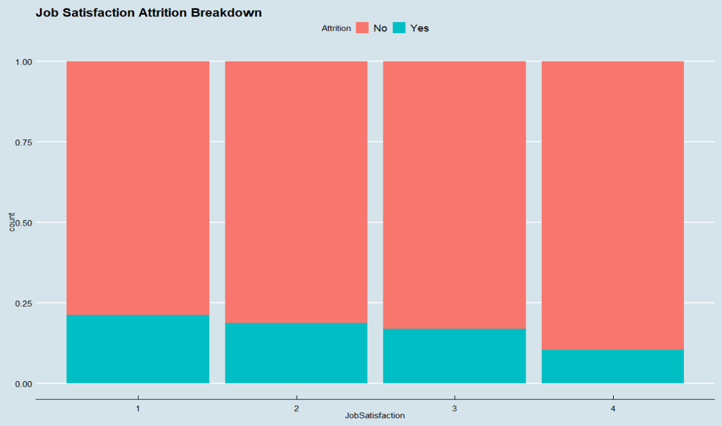
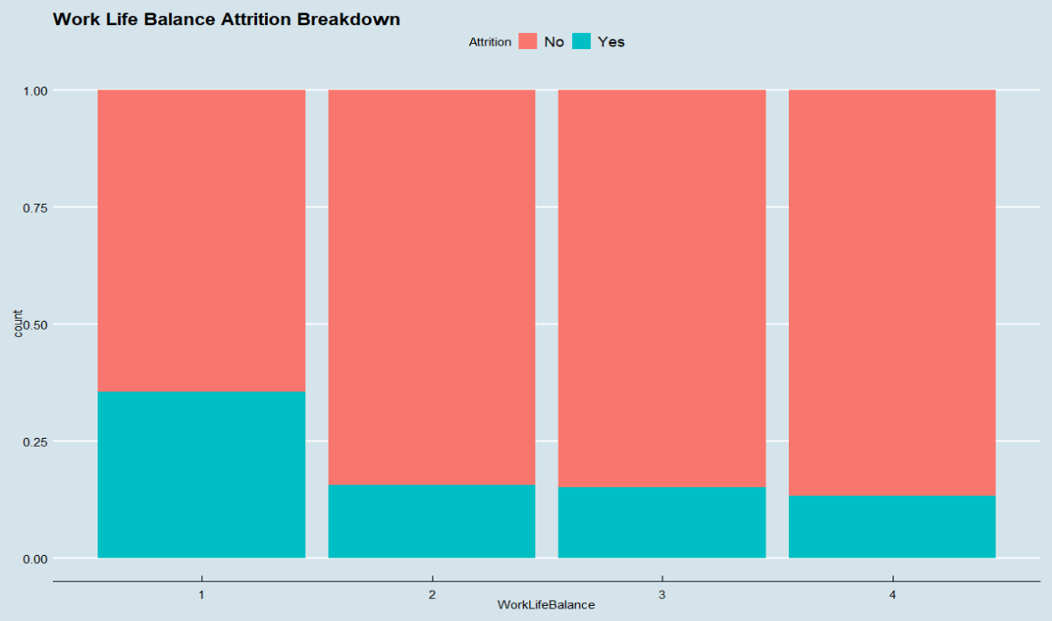
EXPLORATORY DATA ANALYSIS
Bar chart analysis breakdown of attrition (categorical variables)
Notable variables = Job Role, Job Involvement, Job Satisfaction, Work Life Balance

Slide 5
EXPLORATORY DATA ANALYSIS
Notable variables attrition breakdown:
High attrition in Job Role: Sales Reps (45%), Human Resources (29%), Laboratory Technicians (20%)
Job Involvement = 1 has had 47% attrition
Work Life Balance = 1 has had 35% attrition
Job Satisfaction = 1 has had 21% attrition

Slide 6
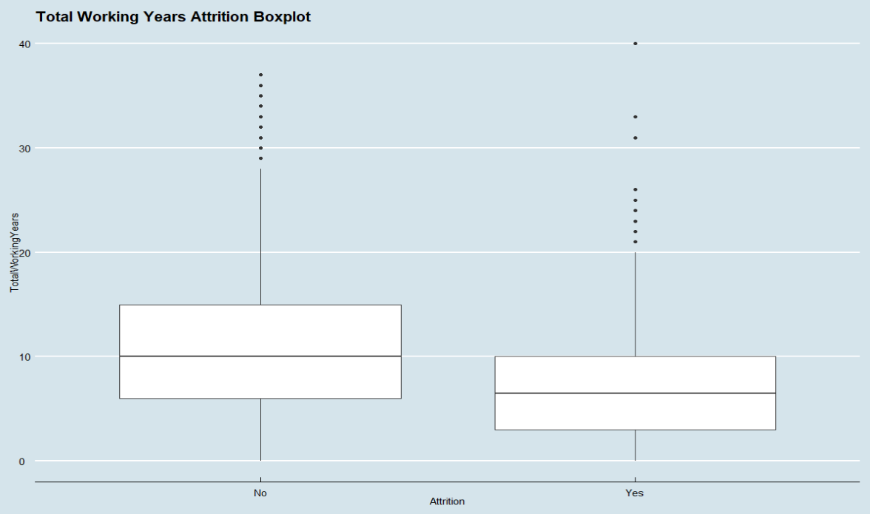
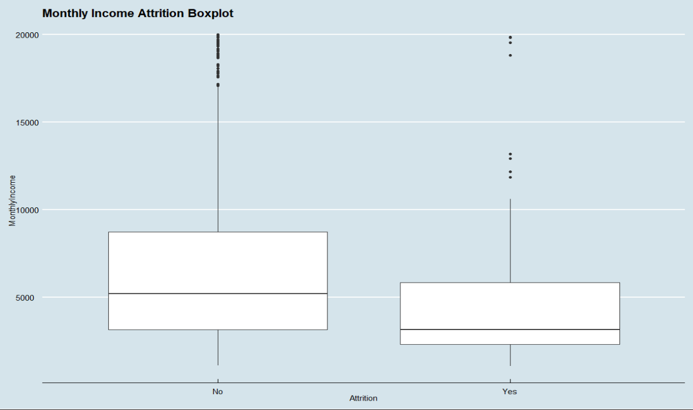
EXPLORATORY DATA ANALYSIS
Box plot analysis breakdown of attrition (continuous variables)
Notable variables = Monthly Income, Total Working Years, Years In CurrentRole, Job Satisfaction, Job Level

Slide 7
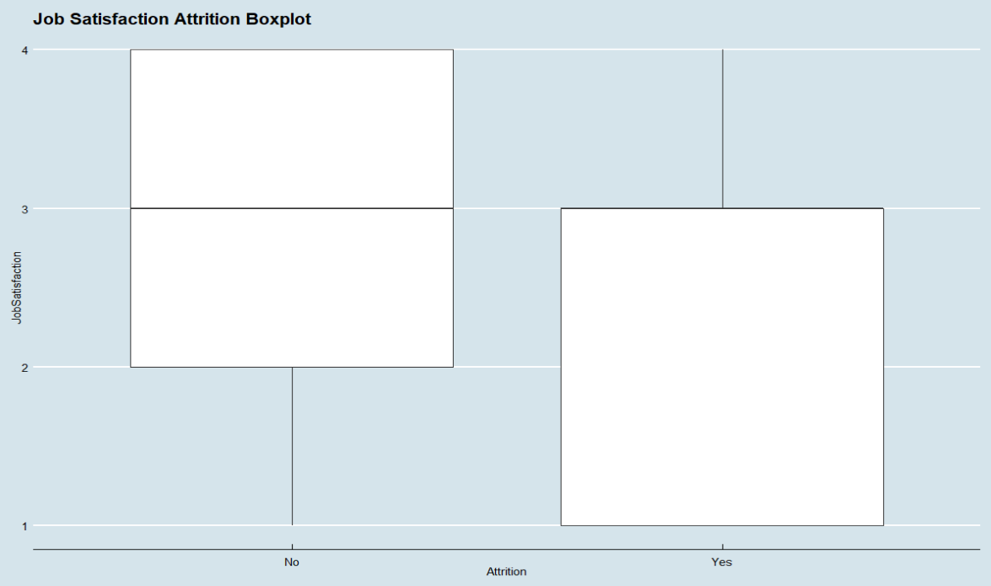
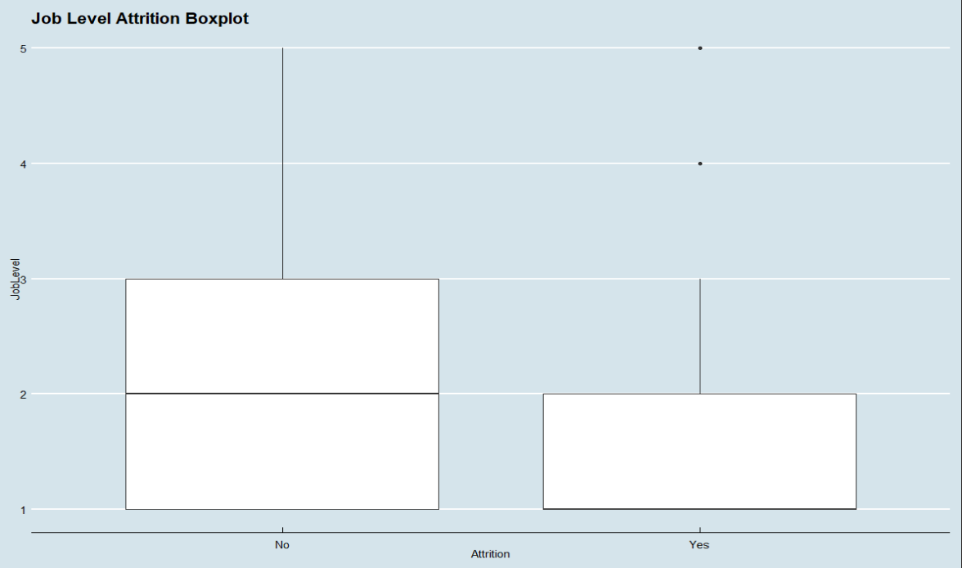
EXPLORATORY DATA ANALYSIS
Box plot analysis breakdown of attrition (continuous variables)
Notable variables = Monthly Income, Total Working Years, Years In CurrentRole, Job Satisfaction, Job Level

Slide 8
EXPLORATORY DATA ANALYSIS
Calculate correlation between categorical variables with attrition with chi squared test
All p-values are statistically significant though the lowest p-value / highest correlation with attrition is the following from high to low:
Job Involvement, Job Role, Work Life Balance, Job Satisfaction

Slide 9
EXPLORATORY DATA ANALYSIS
Calculate correlation between continuous variables with attrition with pearson correlation
Highest correlation with attrition from high to low:
Total Working Years, Years In Current Role, Monthly Income, Distance From Home

Slide 10
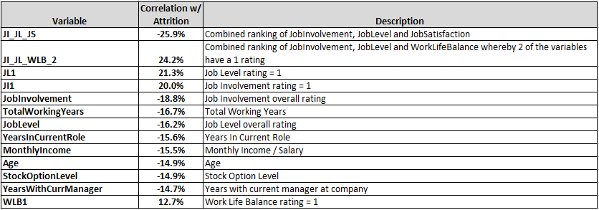
EXPLORATORY DATA ANALYSIS
Calculate correlation with variables, both given variables and created variables
Sorted by absolute correlation

Slide 11
EXPLORATORY DATA ANALYSIS
Test for independence between variables (other than Attrition)
Correlation between categorical variables via chi squared test: JobRole, JobInvolvement, JobSatisfaction, WorkLifeBalance
All p-values are greater than alpha of 0.05 so we conclude that there is independence between these variables
Correlation between continuous variables
High correlation between the following: JobLevel & MonthlyIncome, JobLevel & TotalWorkingYears, TotalWorkingYears & MonthlyIncome
Therefore be mindful of such correlation when testing models

Slide 12
EXPLORATORY DATA ANALYSIS
Summary points before predictive model discussion
Notable variables to analyze further:
Job Role, Job Involvement, Work Life Balance, Monthly Income, Total Working Years, Years In Current Role, Job Satisfaction, Job Level

Slide 13
Predictive Models
Naïve Bayes Model
Description:
Naive Bayes classifier is an algorithm that uses Bayes' theorem to classify objects. Naive Bayes classifiers assume strong, or naive, independence between attributes of data points.
Purpose:
We used Naïve Bayes to create a model that predicts Attrition given particular variables.

Slide 14
Predictive Models
Naïve Bayes Model
Outcome
Total Working Years & combination variable (at least one category = 1 within following categories: Job Involvement, Job Satisfaction, Job Level, Work Life Balance
Accuracy = >72%

Slide 15
Predictive Models
Linear Regression Model
Description:
Linear approach to modelling the relationship between a response variable and one or more explanatory variables
Purpose:
We used Linear Regression to create a model that predicts Monthly Income / Salary given particular variables.

Slide 16
Predictive Models
Linear Regression Model
Outcome
Explanatory variables = Total Working Years & Job Level
R squared = 91%
RMSE = $1390
P-values all approaching 0 = statistically significant

Slide 17
Summary Conclusion
Key Insights
Notable variables related to Attrition
Top 3 = Job Level, Job Involvement, Job Satisfaction
Any rating of 1 within these variables should be noted
Higher Total Working Years is also associated with less attrition
Sales Representatives, Human Resources, Lab Technicians have highest attrition
Notable variables related to Monthly Income / Salary
Total Working Years, Job Level

Slide 18
Summary Conclusion
Recommendations
Employees that have a rating of 1 for notable variables and/or have minimal work experience
Proactively engage to “raise” rating / retain such employees
Recruit employees with more work experience
Especially for employees in the following roles: Sales Representatives, Human Resources, Lab Technicians
Include in survey ratings the option to include “why” behind their ratings to glean insight between different roles and departments
Note individual scores of 1 and seek to incorporate work interaction with others in their department with higher ratings on satisfaction, involvement and level.

Slide 19
THANK YOU FOR YOUR BUSINESS!

